Slide 1
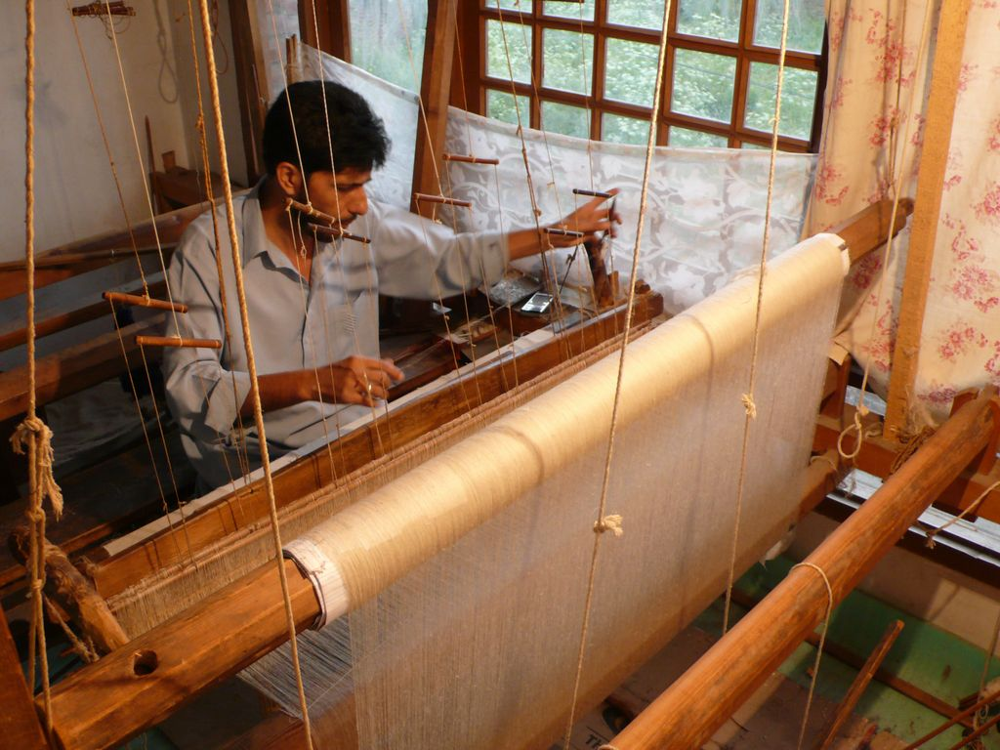
Shawls or Stoles? Resource Optimization at Looms of Ladakh
Balancing Social Mission with Operational Excellence
Presentation by:
Omkar Fulkar | 202402093 | OSCM
Parmar Manank | 202402097 | OSCM
Shivanshu Singh | 202401230 | General
Prasad Gavande | 202401173 | General
Saharsha Bartakke | 202402126 | OSCM

Slide 2
Context - Ladakh & The Pashmina Legacy
Geographic & Community Overview:
India's highest plateau - Changthang region, sparsely populated
Changpa community: Nomadic pastoralists rearing Changra goats
Traditional skills: Women weave/knit, men rear animals
The Precious Fiber:
Changra goats yield pashmina ("diamond fiber")
2.5 lakh goats produce <1% global output, but highest quality
Raw pashmina: ₹7,000/kg vs. finished shawl: ₹10,000+
The Problem:
Price fluctuations, middlemen exploitation
Women have no income source
Youth migrating due to uncertainties

Slide 3
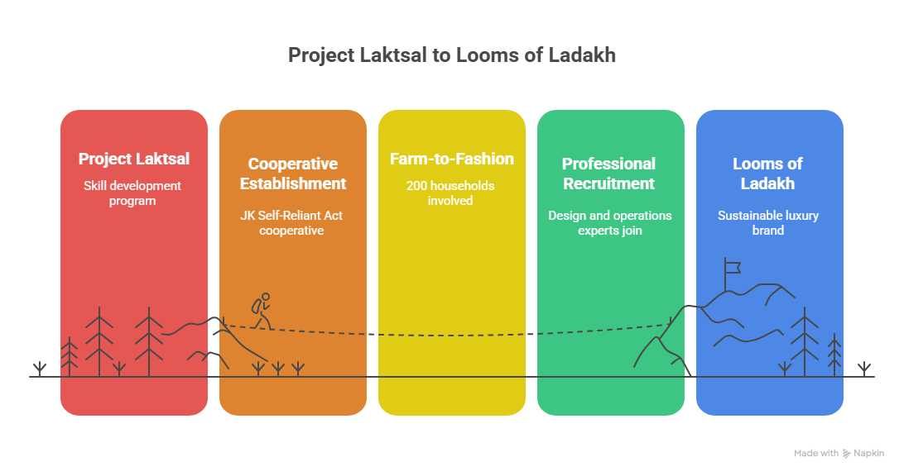

Slide 4




Business Model & Product Portfolio
Market channels
Product Range:
Woven: Shawls, Stoles,
scarves
Knitted: Sweaters, Mufflers,
Caps,Gloves
B2B: Top fashion designers & their platforms
B2C: Flagship store at Leh
E-commerce: Own website + partnerships (Okhai)
Utilize all Ladakh fibers: pashmina, sheep, yak,
Bactrian camel
Balance ecology, culture, and economy
Sustainability Approach

Slide 5

Production Process - Farm to Fashion
Shearing (Spring)
200-400g per goat
annually
Sorting
Separate fine
fiber (<1 micron)
Plying
Single or
twin yarn
Weaving/Knitting
Based on
product type
Washing & Drying
Collection &
preparation
Spinning
Traditional charkha
converts to yarn
Dyeing
60% dyed (outsourced)
,40% natural
Finishing
Sale-ready products
The entire process

Slide 6
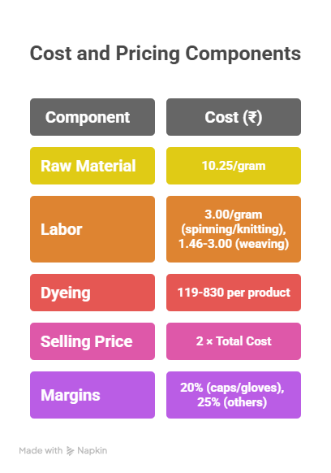
Resource & Cost Structure
Raw Material Requirements (grams/product):
Knitted Product | Grams (Knitted)
Sweater | 320
Muffler | 175
Cap | 75
Gloves | 73
Woven Product | Grams (Woven)
Shawl | 510
Stole | 390
Scarf | 210
Daily Production Capacity (grams/person/day)
Process | Woven (g/person/day) | Knitted (g/person/day)
Spinning | 21.5 | 37.5
Weaving / Knitting | 500 (Weaving) | 50 (Knitting)

Slide 7
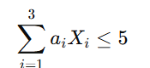


LINEAR PROGRAMMING FORMULATION
OBJECTIVE FUNCTION
Z = 4319.292 X₁ + 3367.338 X₂ + 1940.232 X₃ + 2940 X₄ + 1616.86 X₅ + 554.3 X₆ + 539.62 X₇
Here, all coefficients are the profit of each product.
DECISION VARIABLES
Raw Material Constraints
Woven Products (15,000 grams available):
510·X₁ + 390·X₂ + 210·X₃ ≤ 15,000
Knitted Products (23,000 grams available):
320·X₄ + 175·X₅ + 75·X₆ + 73·X₇ ≤ 23,000
Minimum SKU Constraints (Okhai Launch)
X₁ ≥ 2 , X₂ ≥ 5 , X₃ ≥ 10, X₄ ≥ 2 , X₅ ≥ 4 , X₆ ≥ 5, X₇ ≥ 5
Weaver & Knitter Capacity Constraint
Xi​ = number of units produced of product $i$.
$i$ ∈ {1,2,3,4,5,6,7}
Where,
1 = Shawl,
2 = Stole,
3 = Scarf,
4 = Sweater,
5 = Muffler,
6 = Cap,
7 = Gloves.

Slide 8
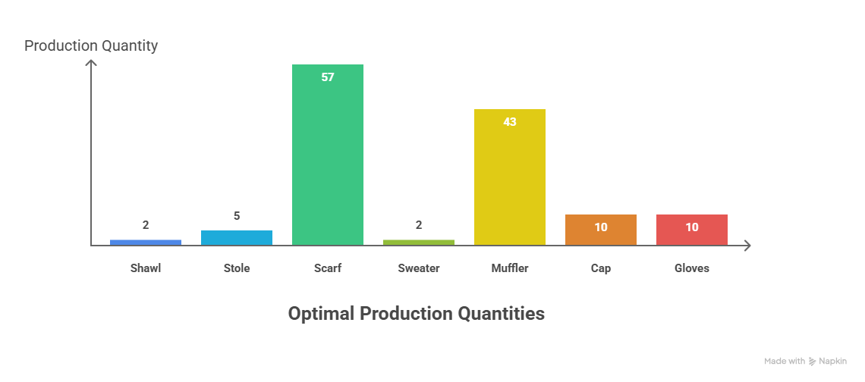
FINAL RESULT
PROFIT: 222967.03 ( PYTHON CODE & EXCEL SOLVER )

Slide 9
